Slide 1
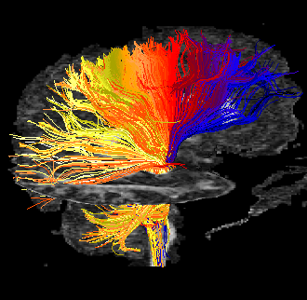
Tractography Limitations
MP / NTP 651

Slide 2
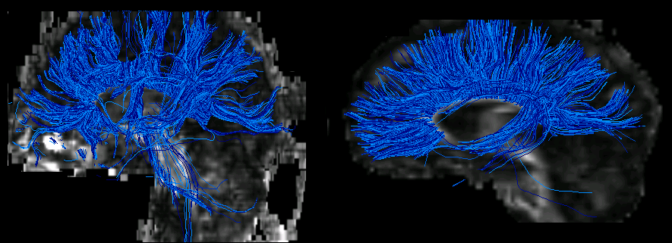
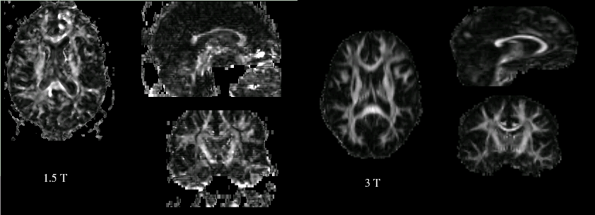
Limitations: Not-so Pretty Pictures
24 y.o. autistic male
26 y.o. autistic male

Slide 3
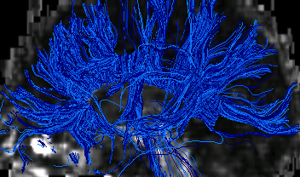
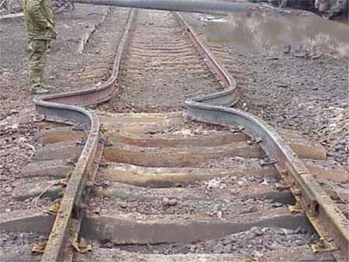
Tractography Errors
Error Sources/Factors:
  Anything that affects DTI accuracy:
Tractography Errors are Cumulative
Tensor Fields are Heterogeneous
(Branches, Crossing, Adjacent WM Tracts)
False Branching & Termination
Visually Apparent DTI Artifacts
=> Tractography Error
    Look at Raw Image Data!
SMALL ERRORS CAN HAVE CATASTROPHIC RESULTS!

Slide 4
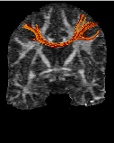
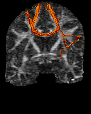
How to Interpret
Pretty Pictures?
If Tractograms Look Realistic – Are They?
Tractograms Usually Look Realistic

Slide 5
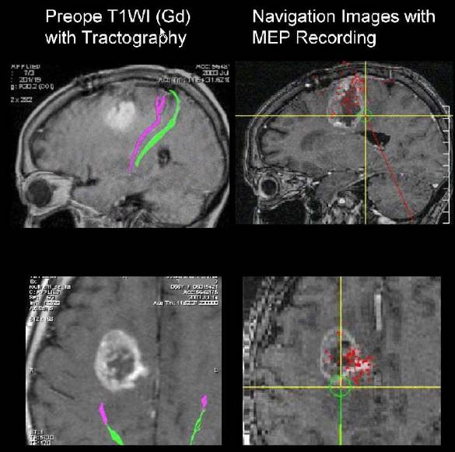
Tractography versus Intraoperative Subcortical Stimulation
Kinoshita et al, Neuroimage 2005
Missed WM tracts adjacent to tumor
Courtesy: AS Field

Slide 6
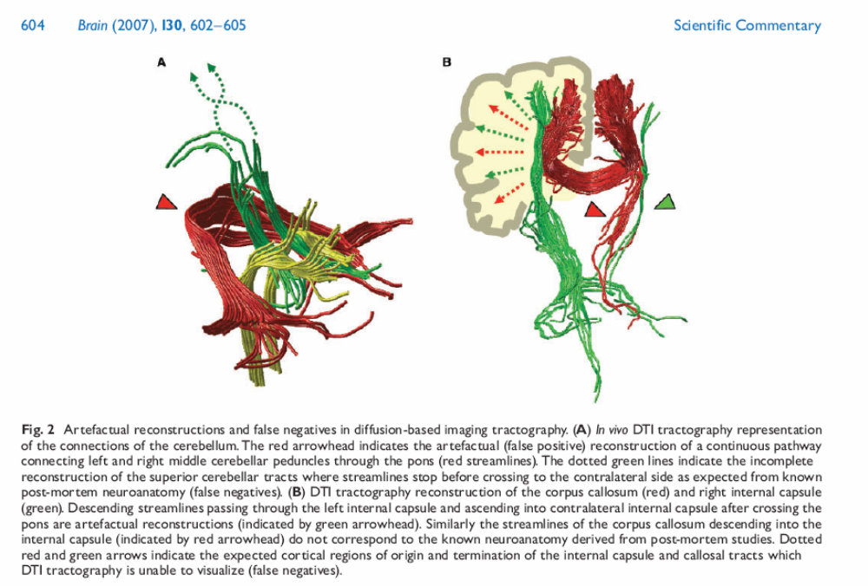
Catani

Slide 7
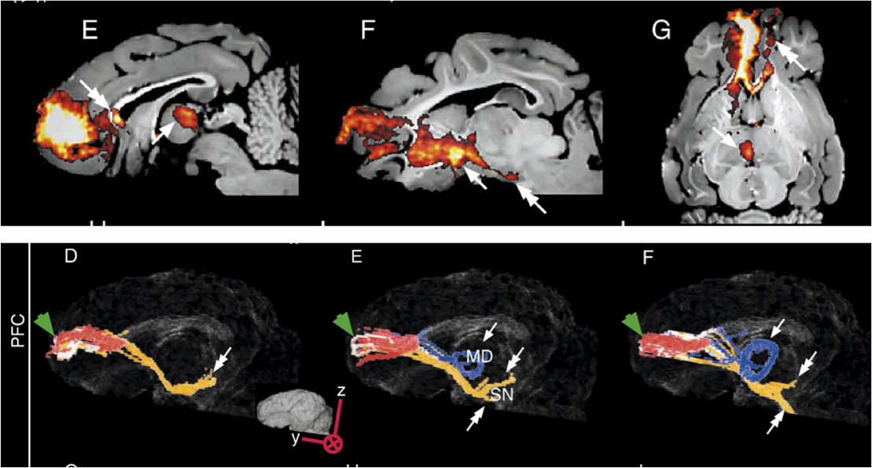
Tracer Validation
Dyrby et al. Neuroimage 2008

